Slide 1
Introduction to BOCES SAMS Financial System
Presented by: Ashley Weil, Associate Accountant
Training Webinar August 31 & September 14, 2021

Slide 2
What we will cover in this training
Federal Funding
State Aid Reminders
BOCES Transportation Services
Logging on to SAMS
7 Steps to Submitting a BOCES State Aid claim
Revising Data in SAMS
BOCES SAMS Financial Reports (Overview)
Understanding & Responding to the Edit Report
Deadlines for Submission

Slide 3
Federal Funding

Slide 4
Federal Funding - Coronavirus Relief
Coronavirus Aid, Relief and Economic Security (CARES) Act
Coronavirus Response and Relief Supplemental Appropriations (CRRSA) Act
American Rescue Plan (ARP) Act

Slide 5
Coronavirus Aid, Relief and Economic Security (CARES) Act
The Coronavirus Aid, Relief, and Economic Security Act, also known as the CARES Act, is a $2.2 trillion economic stimulus bill passed by the 116th U.S. Congress and signed into law by President Donald Trump on March 27, 2020, in response to the economic fallout of the COVID-19 pandemic in the United States. Funds are provided to State educational agencies and school districts to help safely reopen and sustain the safe operation of schools and address the impact of the coronavirus pandemic on the Nation’s students.
New York State School Districts and other Local Education Agencies received $1.2 billion in Federal Funding.
CARES Act funding webpage: CARES Act (nysed.gov)

Slide 6
Coronavirus Aid, Relief and Economic Security (CARES) Act – Expense and Revenue
BOCES expense supported by CARES funds should be recorded in the General Fund on SA-111 Schedule 4 in the Co-Ser from which the expense was made
The revenue should be reported as Other Misc. Deductions Including Components Federal Aid Used to Fund Service in the same Co-Ser.
OSC has provided reporting guidance for CARES funds online: Cares Act Information (osc.gov).

Slide 7
Coronavirus Response and Relief Supplemental Appropriations (CRRSA) Act
On December 27, 2020, the President signed into law the Coronavirus Response and Relief Supplemental Appropriations Act, 2021 (CRRSA Act). The CRRSA Act provides $81.88 billion nationwide in a second Education Stabilization Fund to prevent, prepare for and respond to the coronavirus, of which:
$54.3 billion is for a second Elementary and Secondary School Emergency Relief (ESSER) Fund to support the ability of local educational agencies (LEAs), including charter schools that are LEAs, with emergency relief funds to address the impact that Novel Coronavirus Disease 2019 (COVID-19) has had, and continues to have, on elementary and secondary schools across the nation; and
$4.05 billion is for a second Governor’s Emergency Education Relief (GEER) Fund which provides grants to Governors for the purpose of providing educational agencies with emergency assistance to address the impact of COVID-19. Of the $4.05 billion, $2.75 billion is set aside for Emergency Assistance to Non-Public Schools grants.
CRRSA Act funding webpage: Coronavirus Response and Relief Supplemental Appropriations Act, 2021 (CRRSA Act) (nysed.gov)

Slide 8
Coronavirus Response and Relief Supplemental Appropriations (CRRSA) Act – Expense and Revenue
BOCES expense supported by CRRSA funds should be recorded in the General Fund on SA-111 Schedule 4 in the Co-Ser from which the expense was made
The revenue should be reported as Other Misc. Deductions Including Components Federal Aid Used to Fund Service in the same Co-Ser.
OSC has provided reporting guidance for CRRSA funds online: Federal Aid Received by School Districts under CRRSA and ARP Act (osc.gov).

Slide 9
American Rescue Plan (ARP) Act
Signed into law on March 11, 2021, in response to the COVID-19 pandemic.
It is an unprecedented $1.9 trillion package of assistance measures, including $122 billion for the ARP Elementary and Secondary School Emergency Relief (ARP ESSER) Fund. Funds are provided to State educational agencies and school districts to help safely reopen and sustain the safe operation of schools and address the impact of the coronavirus pandemic on the Nation’s students.
New York State's ARP-ESSER allocation is $8.99 billion. A minimum of 90% of these funds ($8.09 billion) must be allocated to local educational agencies (LEAs), including charter schools that are LEAs
ARP funding webpage: American Rescue Plan (ARP) Act Funding (nysed.gov)

Slide 10
American Rescue Plan (ARP) Act – Expense and Revenue
BOCES expense supported by ARP funds should be recorded in the General Fund on SA-111 Schedule 4 in the Co-Ser from which the expense was made
The revenue should be reported as Other Misc. Deductions Including Components Federal Aid Used to Fund Servicein the same Co-Ser.
OSC has provided reporting guidance for CRRSA funds online: Federal Aid Received by School Districts under CRRSA and ARP Act (osc.gov).

Slide 11
Federal Funding – Coronavirus Relief
Any questions about allowable expenses please contact P12:
Email: CARESAct@nysed.gov

Slide 12
State Aid Reminders

Slide 13
State Aid Reminder: 7 Steps to Submitting a BOCES State Aid claim
Import the XML data file into SAMS
Create & Review the SED Excel File (and a common reporting problem)
Review the Validation Error Report (including how to view data in SAMS forms & common reporting problems)
Review the Aidable Expense 3-Year Trend Report
Run & Review the Edit Exception Report (Overview)
Certify the BOCES State Aid Claim
Verify Certification Using the Activity Log (& more about the Activity Log and SAMS data states)

Slide 14
State Aid Reminder: Unique PSNs
Every Co-Ser needs to have a separate and distinct PSN (Project Serial Number)
This includes all ‘pass-through’ cross contracts, even if multiple services have the same activity code, and even if the same activity is purchased from two different BOCES

Slide 15
State Aid Reminder: Smart Schools Bond Act (SSBA)
The Smart Schools Bond Act (SSBA) authorized the issuance of $2 billion of general obligation bonds to finance improved educational technology and infrastructure to improve learning and opportunity for students throughout the State.
Districts receive allocations; allocation amounts have been determined, but expense must be reported to receive reimbursement
Expenditures supported by SSBA funds may not generate BOCES Aid.
QUESTIONS? Contact the State Aid Office: 518-474-2977

Slide 16
State Aid Reminder: Smart Schools Bond Act (SSBA)
More information on the SSBA expense reporting can be found here: Link will be provided shortly
More information on the SSBA can be found here: http://www.p12.nysed.gov/mgtserv/smart_schools/home.html

Slide 17
State Aid Reminder: Community Schools Set-aside Funds
District projected 2021-22 expenses to be funded with Community Schools Set-aside funds are BOCES aidable, as long as the expenses are for eligible community schools purposes, and supplement not supplant previous community schools expenditures.
http://www.p12.nysed.gov/sss/documents/CommunitySchoolsSetAsideGuidance.pdf

Slide 18
BOCES Transportation Services

Slide 19
BOCES Transportation Services
Thank you for your responses to the BOCES transportation claim verification project. We are processing the data and analyzing the results. Part of the questionnaire focused on whether districts/components claim BOCES transportation services on Form FT Schedule I or Schedule J. Please be aware of the following distinction with student transportation.
Starting with SAMS Claim Year 2021-22 (2020-21 school year):
Districts/components should claim BOCES-provided transportation services on Form FT Schedule I (lines 20 through 23) for the BOCES COSERs 7333, 7334, 7335, and 7337 (these are non-student transportation services).
BOCES COSERs 7331, 7332, and 7336 (student transportation services) should be reported on Form FT Schedule J.

Slide 20
Claim Review
Feel free to call me and schedule a block of time for us to go over your claim together. We can walk through the steps we recommend for reviewing your claim. This is especially recommended for those of you that are new to BOCES SAMS. And as always, feel free to call with any questions about your claim.

Slide 21
Logging Onto SAMS

Slide 22
SAMS Log On
http://portal.nysed.gov

Slide 23
The State Aid Unit does not issue SAMS user IDs or passwords. If new SAMS accounts are needed, or if passwords need resetting, you must contact your SEDDAS administrator which is your BOCES Superintendent..
SEDDAS (SED Delegated Account System) is a program that enables districts to create and maintain their own accounts and reset passwords for SAMS and other SED applications. For more information you can visit: http://www.p12.nysed.gov/seddas/seddashome.html
SEDDAS Help (518) 474-7965

Slide 24
SAMS Logon
Click on SAMS

Slide 25
SAMS Logon:
BOCES SAMS Main Menu

Slide 26
SAMS Logon: Check Entity Information
Use to update BOCES contact information for:
BOCES State Aid Designee
Board of Education Contact
Co Ser System Designee Contact
SA-111 Contact
Procedures to update/change Superintendent information: http://www.p12.nysed.gov/sedrefupdate.html
All State Aid correspondence will go to the State Aid Designee. Whoever is in that role is responsible for communicating with other business office personnel as appropriate
Significant communications from State Aid will also be sent to the District Superintendent
Please ensure the Entity Information is up-to-date for your BOCES
in order to get State Aid correspondences.

Slide 27
Submitting a BOCES Aid Claim
Step 1:
Import the XML Data File

Slide 28
Importing Data
BOCES Financial Data must be imported into BOCES SAMS using a pre-defined XML file format. The XML file is the only mechanism that a BOCES can use to submit BOCES Financial Data into BOCES SAMS

Slide 29
BOCES XML Data file Import

Slide 30
Submitting a BOCES Aid Claim
Step 2:
Create & Review the SED Excel File

Slide 31
The SED EXCEL Template
BOCES can create the SED spreadsheet from any saved “XML” file by using the template which can be found on the State Aid homepage under SAMS Training Material. Template for converting XML files to EXCEL
With a separate tab for each data area that displays all the data in the loaded xml file, examining at least the following 10 tabs in the spreadsheet, plus the Schedule 4 tab, is a critical step in reviewing your submission.
Remember, the Excel file shows you the exact contents of the loaded xml file, not the exact data that is in SAMS. The validation error report (VER) shows what if any data items were ‘kept out’ of SAMS. Only data accepted into SAMS affects your claim.

Slide 32
10 submitted data items that most directly affect aid calculations, appear on Component Output Reports and should be reviewed in the Excel file (red tabs)
SPREADSHEET TAB LABEL | ITEM DESCRIPTION
1. BOC_CAP_EXP_CMP | Component allocation of approved capital outlay and debt service expense
2. BOC_RENT_EXP_CMP | Component allocation of approved rent expense
3. BOC_AIDABLE_EXP_CMP_DATA | Component allocation of aidable expense for admin and services
4. BOC_SCHEDE_CMP | Component allocation of excess salaries for services provided by your BOCES
5. BOC_SCHEDX_CMP | Component allocation of excess salaries for services purchased by your BOCES via cross contract
6.BOC_UNPRV_SVC_PROV_CMP_DATA | Component allocation of the restricted portion of expense for services provided by your BOCES
7. BOC_UNPRV_PURCH_CMP_DATA | Component allocation of the restricted portion of expense for services purchased by your BOCES via cross contract
8. BOC_PRIOR_EXP_REFUND_CMP_DATA | Component allocation of Sch.4 revenue item refund of prior year expense (A2701)
9. BOC_MISC_DEDUCT_CMP | Component allocation of other miscellaneous deductions, including components' federal aid used to fund service
10. BOC_ADMIN_DEDUCT_CMP | Component allocation of the selected admin deduct (for most BOCES this is the same as excess salaries total for admin)

Slide 33
Creating the SED EXCEL File
1. Create a new XML file from your financial data system
2. Save the XML file to your PC
3. Open your most recent BO xxxxxx mmddyy V9.XLSX spreadsheet
4. Choose Data, XML, Import from the top menu
5. Select the file saved in step 2 above and click Import
6. Choose File, Save As, and save your spreadsheet with a meaningful name
7. After you have completed importing the data into SAMS we suggest that you copy and paste the Import Validation Error Report (which SAMS emails to the user) into the second tab of this template.
8. Save your file again.

Slide 34
Sample Tab in SED Excel File: BOC_AIDABLE_EXP_CMP_DATA

Slide 35
Sample Tab in SED Excel File: BOC_MISC_DEDUCT_CMP

Slide 36
What to Look for in Excel File (Examples)
Eyeball each tab making sure that:
Both actual and projected column have data where appropriate;
Rent tab & Capital tab are not blank if you have rent and/or capital expense;
Rent & Capital data is for appropriate year (2021-22 data for payment / 2022-23 for estimate)
Both provided and cross-contract service data is displayed where appropriate

Slide 37
Review Excel File to Find this Common Reporting Problem: Aidable Expense / No Deductions
Many instances of aidable expense allocation reported without accompanying deductions for the service; e.g., no excess salaries
If you allocate aidable expense for a service for the prior or current (projected) school year, related deductions, especially excess salaries, must also be reported
Problem greater in projection year: Must estimate excess salaries and unapproved services for existing contracts
Look at the Excess Salary tabs in Excel file & make sure there is sufficient data in projected

Slide 38
Submitting a BOCES Aid Claim
Step 3:
Review the
Validation Error Report (VER)

Slide 39
Validation Error Report VS. Edit Report
Validation Error Report (VER)
Emailed to the State Aid Designee only.
Automatically generated when XML file has finished loading
Informs the user about what data from the XML file has & has NOT been accepted into SAMS
Data excluded due to various formatting or PSN/Activity code issues
Edit Report
Is run by a user in SAMS after the XML file has been loaded (See Step 5)
Edits apply only to data that has been accepted into SAMS
Applies programmed parameters to various data areas to identify outlier values, missing data, etc.

Slide 40
Validation Error Report
Automatically sent by email to the BOCES State Aid Designee and the subject line shows the following:
BOCES XML Import Results for FILE: ‘XXXXXXXX.XML' Time of Import: 09/02/2014 03:44 PM
If you receive an email with this in the subject line:
**CRITICAL ERROR** BOCES XML Import Results for FILE: ‘XXXXXXXXXX.xml' Time of Import: 06/26/2014 11:33 AM, it means significant parts of your XML file did not successfully load into SAMS (not just minor format issues). When this occurs a new XML file will be needed; due to there is an issue loading the data.

Slide 41
Validation Error Report (VER): Sample Error Message / Code Problem
F-PSN-ACCT-OBJ Actual Projected Error
A-307-4670-150 43394 0 307+Activity 4670 not on LAS.
Means this PSN / Activity code combination is not active on your LAS, or not active on provider’s LAS if this is a purchased svc
Could be new PSN not yet approved by program office
Could be expense for this PSN was on XML file with different activity code than on LAS
If purchased svc, could be PSN reported on your XML file with different State Activity code than provider assigned on their LAS
Whatever the reason, this error means the values are in the XML file but are not being allowed into SAMS

Slide 42
Validation Error Report (VER): Sample Error Message / Code Problem
F-PSN-ACCT-OBJ Actual Projected Error
A-307-4670-150 43394 0 307+Activity 4670 not on LAS.
As indicated above, this error can occur if PSN for a cross-contracted service is reported on your XML file with a different State Activity code than provider assigned on their LAS
For ‘pass-through’ cross contracts (services purchased for your components, not for your own BOCES), the 4-digit State Activity Code reported in SAMS by the purchasing BOCES must match the 4-digit code on the provider’s LAS and on the cross contract form
Mis-matched activity codes can keep data out of SAMS, cause inaccurate data to display on SAMS forms / reports and cause your components to lose aid.

Slide 43
Validation Error Report (VER): Schedule 4: Valid Account Codes
0000 is not a valid account code for any service
The account code field cannot be left blank for any Schedule 4 data record
Also, state activity code for any career education Co-ser must be on the program office list of possible career ed codes
All these errors will show on the VER and will prevent reported expense from entering SAMS.
These errors must be addressed for SAMS to have valid SA-111 data and for SAMS to calculate aid correctly.

Slide 44
View CO-Ser Level Data in SAMS
Looking at SAMS Form data related to specific PSNs can help research VER errors, edit exceptions, etc.
You can look at / verify component allocations for aidable expense, excess salaries, unapproved services, rent and capital, etc. for individual PSNs
All data displayed on SAMS forms has been accepted into the SAMS database; check VER if expected data is missing from a form

Slide 45
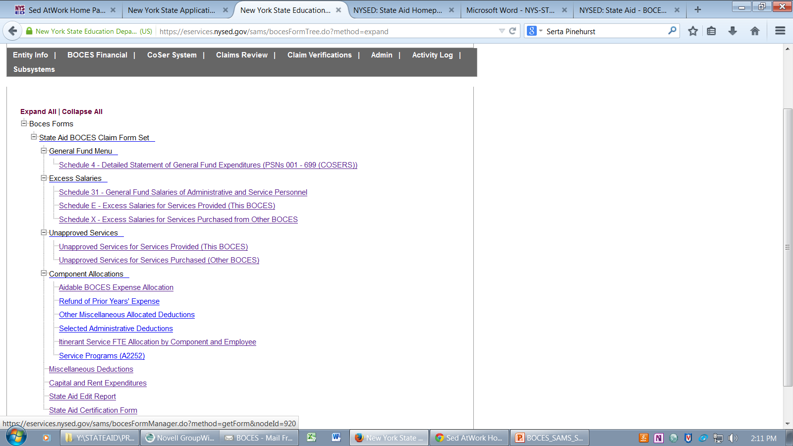
How to View CO-Ser Level Data in SAMS

Slide 46
Look up Information by PSN
Use to enter your own CoSers
Use to enter when purchasing CoSers from another BOCES

Slide 47
Your Own Service

Slide 48
Cross Contract

Slide 49
Your Own Service VS a Cross Contract
Your Own Service
Cross Contract

Slide 50
Submitting a BOCES Aid Claim
Step 4:
Review Reports in SAMS

Slide 51
Reports
To access the reports:
Click on BOCES Financial from Main Menu
Click on the report you would like to review under the heading BOCES ‘Expense and Other Reports’

Slide 52
Submitting a BOCES Aid Claim
Step 5:
Run & Review Edit Report, Revise Data if Needed or Comment Substantively on Edit Exceptions

Slide 53
Edits: Who Needs Them?
Edit Report Overview
You: To ensure the data you have reported is as you intended
Us: Part of our ‘due diligence’ in paying /projecting the correct aid amount
Others: Internal & external parties that request explanations behind aid /data fluctuations & other anomalies

Slide 54
Running the Edit Exception Report
The BOCES Financial Form Set Edit Exception Report must be run and all edit exceptions addressed before the BOCES Superintendent can certify and submit the claim to SED. The Edit Report can be found at the end of the form set menu.
To run the edit exception report:
Select the edit report from the Form tree
Click Run New Report
You must Review the edit exception report and change/correct any data items if needed before submission. All remaining exceptions must be explained in substantively and in sufficient detail.
Edit report must be marked READY before the BOCES Superintendent can Certify and Submit to SED

Slide 56
Running the Edit Exception Report

Slide 57
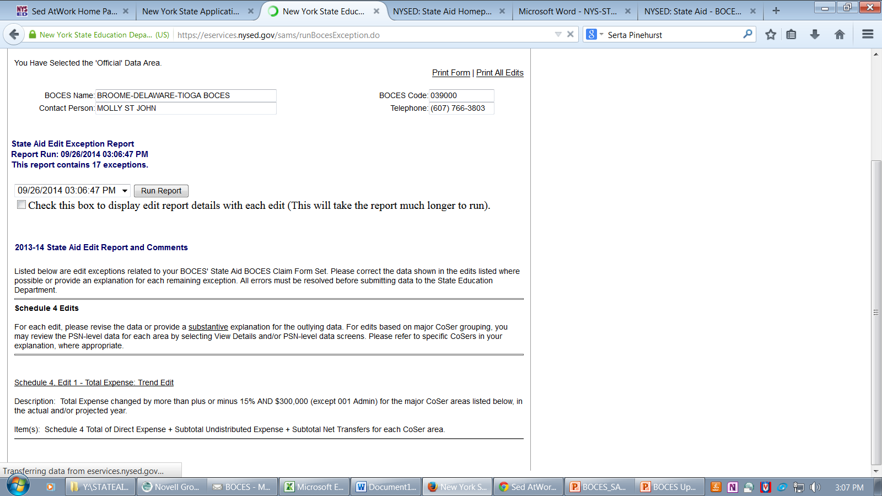

Slide 58
Display all ‘View Details’
Option to check a box that will display all the ‘view details’ reports for all edit exceptions, instead of choosing view details for each edit (Report will take longer)

Slide 59
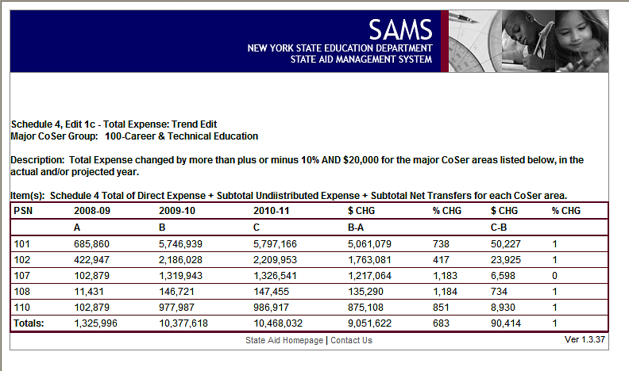

Slide 60
Reasons for Edit Exceptions
Common reasons for edit exceptions include:
Missing data
Large increase/decrease in year to year amounts
Significant discrepancies between component allocation totals and BOCES-level totals
More about edits later…

Slide 61
Submitting a BOCES Aid Claim
Step 6:
Certifying the BOCES State Aid Claim

Slide 62
Certifying the BOCES Aid Claim
The Certification Form can be found in the BOCES Official Data Area at the end of the menu choices under “State Aid BOCES Claim Form Set”
The form set must be Certified by the District Superintendent; please check that the DS has a valid SAMS account/password before it’s time to certify
The Edit Report must be in the “Ready” state before Certification
Certify and Submit your data to State Aid.
To verify that SED has “received” your submission, check that the activity log has a data state entry of “Certified” for the form set you submitted.
You may not upload another file until you receive a “Clean,” “Clean with Issues, or “Rejected” email notice from SED

Slide 63
Submitting a BOCES Aid Claim
Step 7:
Go to Activity Log to Verify Successful Submission

Slide 64
Verify Certification on Activity Log
If the Activity Log shows the data state of the BOCES State Aid Claim Form Set and the BOCES State Aid Claim Edit Report is Certified, that means the claim has been submitted and is awaiting SED review
When the data state becomes Edit in Progress, SED has begun to review

Slide 65
Activity Log
Allows you to track all activities and status associated with the data you have submitted to State Aid and the CoSer System.
Information displayed in the activity log will let you:
Verify the data state and data state date of any form set: (e.g. Certified, Clean)
Identify when a Form Set has been Rejected and needs your Attention (edit rejected, correction rejected, revision rejected)
Review automated correspondence sent by SED
Identify BOCES or SED staff responsible for each activity
Can filter sort by Form Set
Can sort by any column on the log by left-clicking on the column heading.

Slide 66
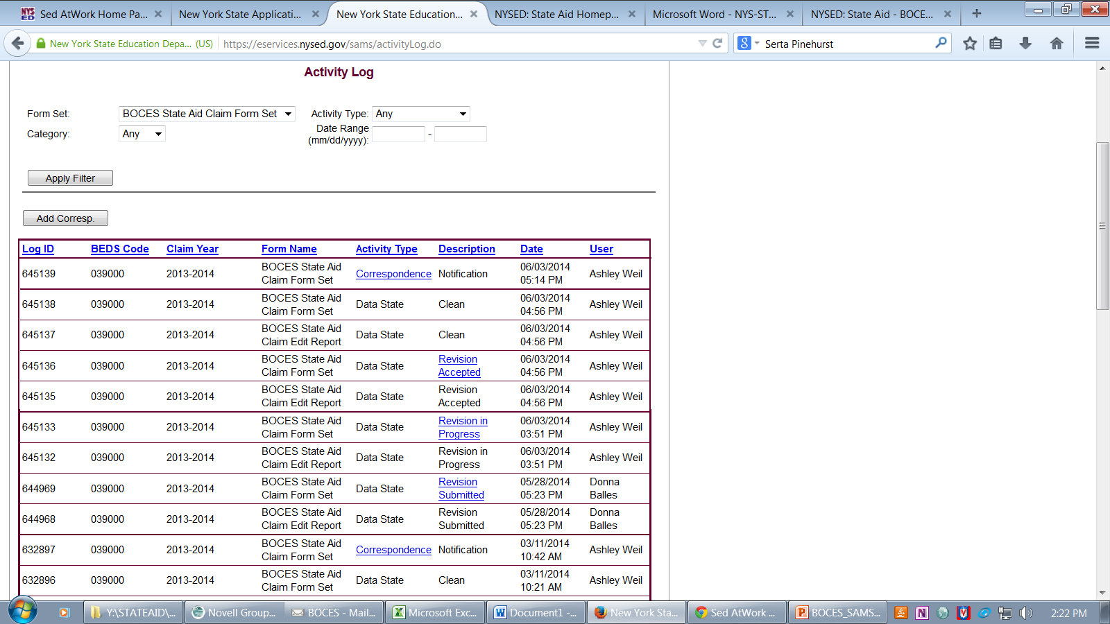
Activity Log

Slide 67
Using the Activity Log
Use Activity Log to confirm all interactions with SAMS
BOCES should confirm that each action taken; e.g., Certify, Submit Revision, etc. that the expected data state appears on the log
Watch for Rejected State – the ball’s in your park; you must run a new edit report to see SED comments and either change problem data or provide additional explanation
Your State Aid form set has not been accepted by SED for inclusion in the Nov 15 DB until activity log shows Clean or Clean with Issues! Corrections or revisions submitted are not included in SAMS official until activity log shows Corrections Accepted or Revision Accepted

Slide 68
Activity Log: About SAMS Data States
(samples – see Training Manual for a full list & descriptions)
Clean | All Edit Exceptions have been adequately explained or there are no edit exceptions when submitted.
Clean with Issues | Edit Exceptions still exist but the data is acceptable for Nov. 15 State Aid projections. Issues should be resolved by mid-January
Corrections Submitted | BOCES has submitted corrections to SED during the edit process. (This state can only occur prior to the ‘clean’ or ‘clean with issues’ state
Edit in Progress | SED is in process of editing district’s submitted data. BOCES cannot submit changes to data while in this status.
Edit Rejection | SED has rejected an Edit Exception Report from the BOCES during SED edit process.
Revision Review in Progress | SED has begun reviewing revised data submitted by the BOCES.
Revision Submitted | Revised data has been submitted to SED by the BOCES

Slide 69
Revising Data in SAMS

Slide 70
Revision Data Area
The Revision Data area is used to make changes/corrections to your data ONLY after your initial data has been “Certified, Submitted, and Reviewed by SED.”
STEP 1
Make your Changes
Generate a new data file from your financial system.
Import new data file into REVISION data area
Check the VER (Validation Error Report) for what was loaded into SAMS
Run the Edit Exception Report
Address errors, make comments, “Save and Ready”
STEP 2
Submit your Changes
You must submit your changes to State Aid for any form that was modified.
Select “BOCES Financial Change Submission Form.
Click Submit Changes
Wait for SED to Clean, Clean with Issues or Reject before uploading another XML file.

Slide 71
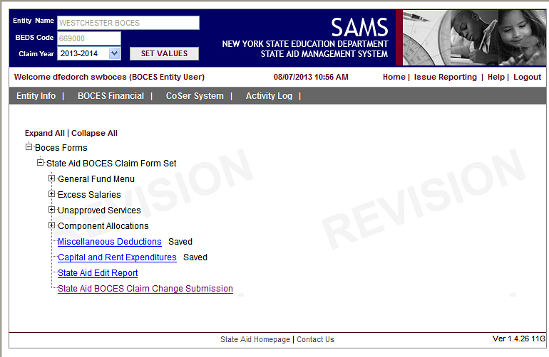
Step 2: Submit your changes

Slide 72
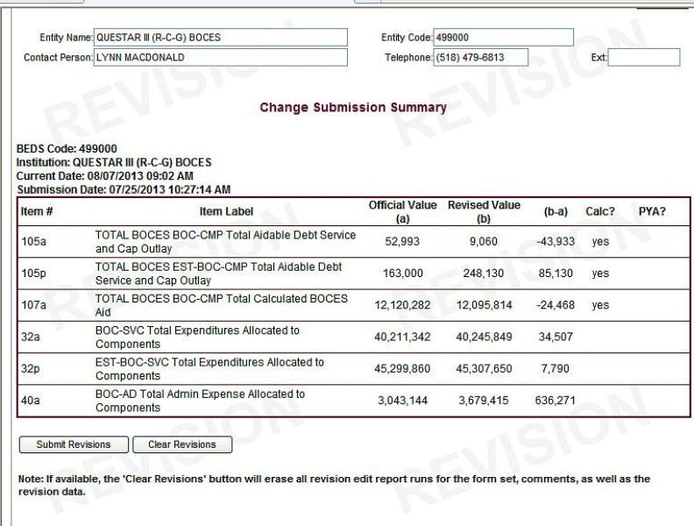
Change Submission Summary

Slide 73
BOCES SAMS Financial Reports (Overview)

Slide 74
Accessing BOCES SAMS Financial Reports
Easiest way to see the list of all available reports: Click on ‘BOCES Financial’ from the BOCES SAMS Main Menu
Some reports are for individual PSNs, some for individual components, some are BOCES level
Filter options and instructions vary across reports

Slide 75
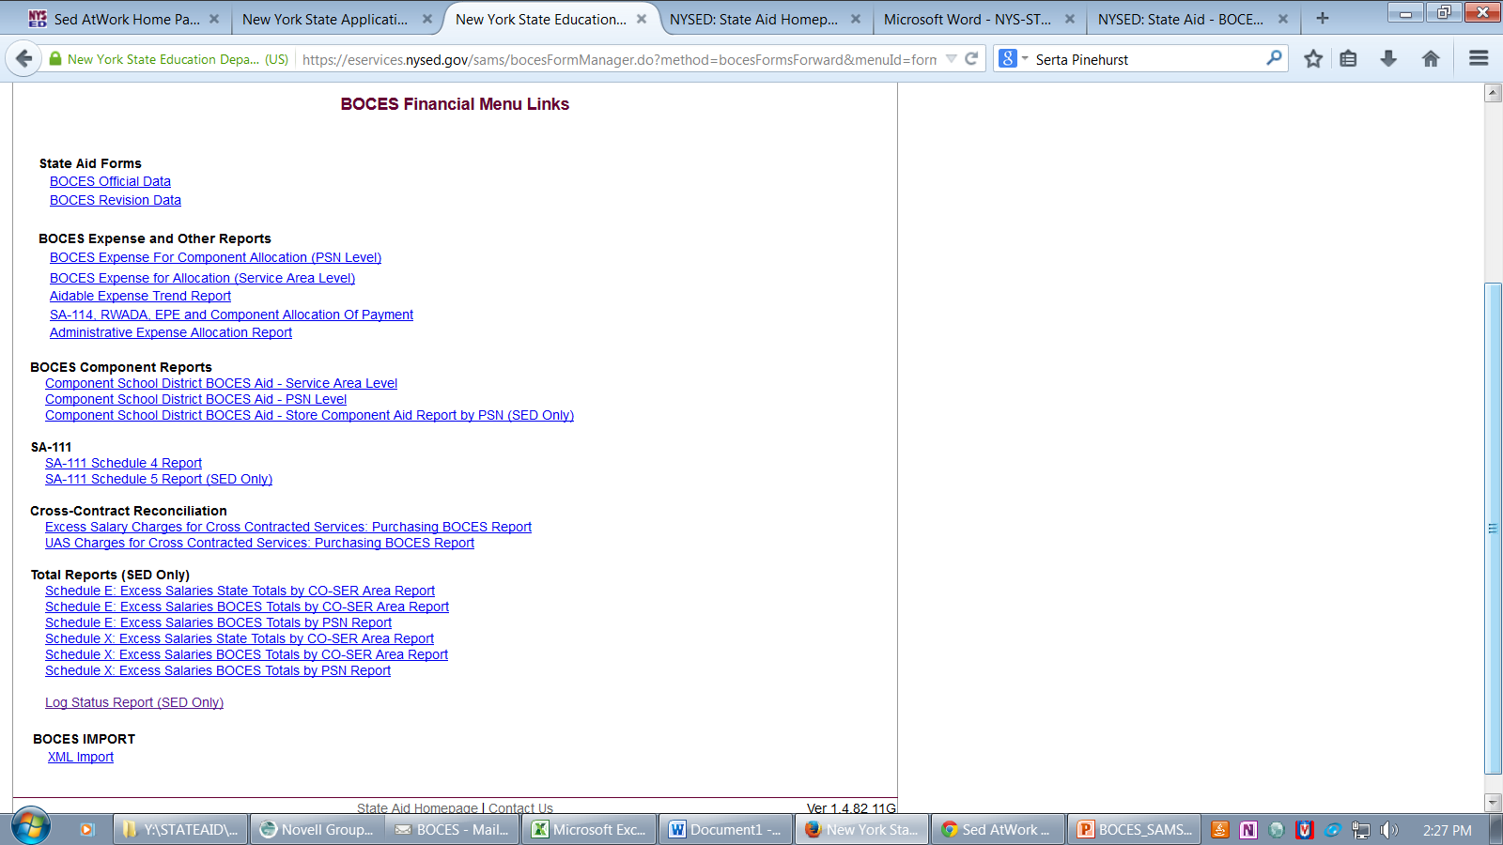
BOCES Financial Menu Links

Slide 76
BOCES SAMS Financial Reports
Financial reports that can be accessed in BOCES/SAMS.
BOCES Report DEMO

Slide 77
Selected Report Filter Options
Select Data Area
Official – Reports usually viewed here
Revision – View here to see impact after uploading revisions
Select Data Version Date
Midnight Last Night (always source of Public Web View when selected reports are published in late fall)
Current Date/Time
Snapshot – Select an available snapshot (E.g. Nov. 15, 2021 database, or Feb. 2022 BOCES payment)
Some reports have other filter options

Slide 78
Snapshots
Display data on a report as it existed at a point in time
Snapshots are now available for most reports in SAMS
Use to compare current aids with aids computed as of a payment date, November 15 database, Sept. payment, etc.
Due to snapshot capability, SED no longer mails printed output reports to BOCES after each payment

Slide 79
Component School District BOCES Aid Report – Service Area Level
Determines actual aid payable this year
Found under ‘BOCES Component Reports’ heading on menu
Choose a district to see aid calculated by service area and total aid payable to district
Selected aid ratio and aid amounts may not be valid until item #7 (tax levy) has data, indicating district has saved the ST-3 form
All expense amounts are based on BOCES reporting

Slide 80
Component School District BOCES Aid Report – PSN Level
Found under ‘BOCES Component Reports’ heading on menu
Contains same data as service level cmp report (alloc exp, all cmp deductions, aidable expense, current yr aid), but report displays data by individual PSN
User can choose one PSN, all PSNs, or all PSNs in a service area
User can choose one component or all components

Slide 81
Understanding the Edit Report

Slide 82
Major CoSer area trend edits
You see this at the start of this section of the edit report:
Schedule 4, Edit 1 - Total Expense: Trend Edit
Description: Total Expense changed by more than plus or minus 15% AND $300,000 for the major CoSer areas listed below, in the actual and/or projected year.
Item(s): Schedule 4 Total of Direct Expense + Subtotal Undistributed Expense + Subtotal Net Transfers for each CoSer area.

Slide 83
Major CoSer area trend edits
These edit parameters are applied to changes in the total of expense items listed above for all PSNs in the each major service area
Report will show you only the service areas for which the total svc area expense change exceeded the parameters in either the actual or projected year

Slide 84
Sample Trend Edit
The edit appears only because the bottom row total change from 12-13 to 13-14 exceeds 15% and $300K. The detail table displays shows all PSNs with data in this services area; however, the BOCES need only explain the ‘prior to actual’ change in PSN 435 in the comment on this edit, as that change is primarily responsible for the exception.

Slide 85
Major CoSer area Trend Edits
How to Respond Do’s and Don’t
Do: explain the trend in total change, for one or both year-to- year comparisons
Don’t: explain the change in each and every PSN listed; remember that detail table lists all PSNs in the service area, but the edit exception is due to large changes in the totals for the service area
But: trend in total change may be due substantially or primarily to change in one or two PSNs, in which case it’s OK to only explain fluctuation in that PSN

Slide 86
Trend Edits Suggestions
Look at prior to actual change and actual to projected change separately……and together
Provide best insight you can into the fluctuation in the service area.
Sample explanations:
One year ‘spike’ because.…
Multiple year downward trend because…
Participation in PSN 456 fluctuates a lot from year to year and is the source of most of the fluctuation in the whole service area…

Slide 87
Rent and Capital Edits
4 separate, “0” edits that will tell you that you have reported no data in rent for current aid year, projected rent, capital for current aid year, projected capital: BOCES must confirm in comment area that “0 is OK” or resubmit
(Failing to report any capital and/or rent expense is a recurring problem; following the review guidance above prior to certifying the claim should reveal this error before edit report is run)

Slide 88
Rent and Capital Trend Edits
Trend edits will be based on totals of component allocations
Edit will kick out if either prior to actual or actual to projected parameters are exceeded
Please provide substantive explanation for edit exceptions; e.g., for large increase/decrease in capital expense:
Example of not enough detail: Project started or Project finished
Example of too much detail: Started/finished Project # 003 adding 3 classrooms to Building 2, Project #004 replacing windows in Bldg 3, Project # ___, etc.
Example of just right detail: Anticipate starting (or finished) HVAC project and addition of several classrooms

Slide 89
How to Investigate a Rent or Capital Trend Edit
Go to the Rent and Capital form in SAMS
Choose from top menu bar: BOCES Financial, State Aid Forms, Official or Revision, then click on State Aid BOCES Claim Form Set, then on Capital and Rent Expenditures
Form displays the component allocations for rent and for capital that are in SAMS; shows 3 years of expense
Missing or very wrong data is immediately visually obvious
REMEMBER: Expense for rent and capital should be reported for same year as aid year; e.g., 16-17 expense for 16-17 aid

Slide 90
The Rent & Capital Claim process

Slide 91
Rent & Capital Claim Process
These are the only expenses aided on a current year basis
In 2021-22 BOCES SAMS, report 2021-22 rent and capital expense for 2021-22 aid and
In 2022-23 BOCES SAMS, report 2022-23 estimated rent and capital expense for 2022-23 projected aid

Slide 92
Rent & Capital Claim Process
Rent and Capital Aid is calculated based solely on allocated rent and capital expenses submitted in the SAMS State aid claim form
Project costs, bond information, leases, SA-109, SA-116 etc, submitted to SED, affect the amounts that should be entered in the SAMS allocated rent and capital areas, but only the actual SAMS aid claim expenses determine rent and capital aid.

Slide 93
Rent & Capital Claim Process
The rent and capital claim process starts on October 1st with the submission of rent and capital expense in SAMS as part of the annual aid claim
Both current and projected SAMS amounts can/should be revised throughout the claim year to reflect any significant changes in the status of leases or capital projects
Components are entitled to have their aid payments and Executive and Enacted budget projections be accurate to the best of your reporting ability
What to submit in SAMS may be straightforward, or it may require your best judgment as to how lease/project status will unfold during the current and projected school year.

Slide 94
Capital Claim Process
For a capital project to be aided in a claim year, the contract must be signed and an SA-139 must be submitted by June 30th of the claim year (and the contract must be signed after the Commissioner’s Approval Date (CAD)
Capital expenses may be claimed in SAMS before the contract is signed, but this should only be done if you are quite certain the contract will be signed by 6/30 of the aid year

Slide 95
Capital Claim Process
In addition to components’ actual debt service expense, the amount claimed in SAMS can be the component expense paid to the BOCES for actual or anticipated BOCES project expenditures.
However, under no circumstances will aid be paid to reimburse components for actual or anticipated project expense paid to the BOCES if no SA-139 is received by 6/30 of the aid year
If components have paid the BOCES during the aid year, and the BOCES has claimed aid, and no SA-139 is submitted by 6/30 of the aid year, BOCES should observe appropriate laws and regulations regarding the funds collected from components.

Slide 96
Capital Claim Process: The SA-109
The purpose of the SA-109 is to determine the exact amount per project of aidable capital expense that can be claimed for an aid year
By the end of the aid year, the allocated capital amounts on the SED-approved SA-109 and the allocated capital amounts in SAMS must be equal.
The 2018-19 claim year will be the first year the SA-109 is in SAMs.
The new forms are available as so as SAMs is released.

Slide 97
Capital Claim Process: The SA-109
The new facilities form set is under the State Aid BOCES Claim Form Set
The form can be filled out at your convenience
YOU CAN ONLY SUBMIT THE FORM ONCE.

Slide 98
Capital Claim Process: The SA-109
The projects that are loaded will be listed in the summary form

Slide 99
Capital Claim Process: The SA-109 Bond

Slide 100
Capital Claim Process: The SA-109 Bond

Slide 101
Capital Claim Process: The SA-109 Bond

Slide 102
Capital Claim Process: The SA-109 Capital

Slide 103
Capital Claim Process: The SA-109 Capital

Slide 104
Capital Claim Process: The SA-109 Capital

Slide 105
Capital Claim Process: The New SA-109

Slide 106
Capital Claim Process: SA-109
Because there can be activity on a capital project in the last weeks of the school year, and lags between Facilities Planning processing and State Aid processing, as well as wait-time for the system to process changes, finalizing your BOCES capital claim often requires engagement of BOCES and SED staff

Slide 107
Capital Claim Process: SA-109
The SA-109 must be completed by any BOCES that has an actual capital claim for the aid year and is due May 1st of the claim year
If capital expense was claimed in SAMS during the aid year, but by May 1st it is clear there will be no actual claim, then no SA-109 is needed, but the BOCES must revise SAMS to delete the allocated capital expense
Extensions beyond May 1st may be granted if a contract will be signed by June 30th but has not been signed by May 1st, or possibly for other reasons. The BOCES should contact SED to discuss the specific situation

Slide 108
Rent Claim Process: SA-116
The purpose of the SA-116 is to determine the exact amount of aidable rent expense that can be claimed for an aid year
By the end of the aid year, the allocated rent amounts on the SED-approved SA-116 and the allocated rent amounts in SAMS must be equal.
SED reviews the SA-116, and then advises the BOCES whether a SAMS revision should be submitted to reflect the actual SA-116 claim, OR whether the SA-116 should be revised.
SED would appreciate prompt action in these cases as the ‘off-line’ nature of this process makes it cumbersome to track compliance

Slide 109
Rent Claim Process: SA-116A
The SA-116 must be completed by any BOCES that has an actual rent claim for the aid year and is due May 1st of the claim year
Extensions beyond May 1st may be granted on a case by case basis. The BOCES should contact SED to discuss the specific situation.

Slide 110
Capital Claim Process: The SA-116A
The projects that are loaded will be listed in the summary form

Slide 111
Capital Claim Process: The SA-116A

Slide 112
Capital Claim Process: The SA-116A

Slide 113
Capital Claim Process: The SA-116A

Slide 114
Capital Claim Process: The SA-116A

Slide 115
Capital Claim Process: The Capital Claim Edit Report

Slide 116
Capital Claim Process: The Capital Claim Edit Report

Slide 117
Capital Claim Process: The Capital Claim Edit Report

Slide 118
Capital Claim Process: The Capital Claim Edit Report

Slide 119
Capital Claim Process: The Capital Claim Edit Report

Slide 120
Fall Deadlines for Submission
October 1 – BOCES Financial Data Set must be Certified
Reminder - Edit Report must be marked “Ready” before District Superintendent can Certify
Reminder – The Certify/Submit button must be pressed for State Aid to be able to review the file
Submissions must be substantially complete for both current and projected year before being certified
November 1st : Last day to submit revisions to guarantee SED processing in time to be included in Nov. frozen data file

Slide 121
Questions?
Please feel free to contact the State Aid office with any questions regarding the reviewing and submission of your BOCES State Aid claim.

Slide 122
Contact us:
State Aid Office:
518-474-2977
Email: BOCES@NYSED.GOV
Website: https://stateaid.nysed.gov

